Slide 1
Electronics – Power SupPly circuit
By : Ahmed ashour

Slide 2
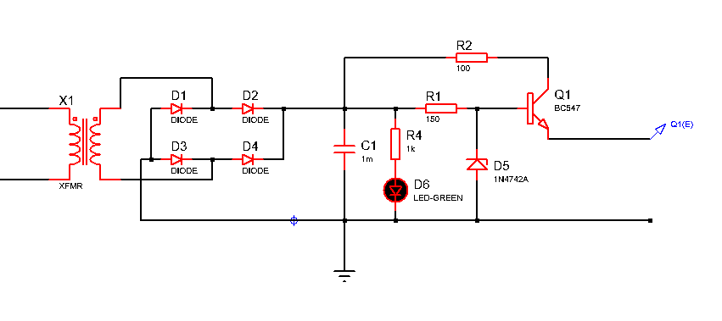
Power supply circuit
The power supply circuit is made of 6 parts which is :
The transformer
The diode bridge
Smoothing capacitor
Voltage regulator (zener)
The buffer transistor
Power on indicator (LED)

Slide 3
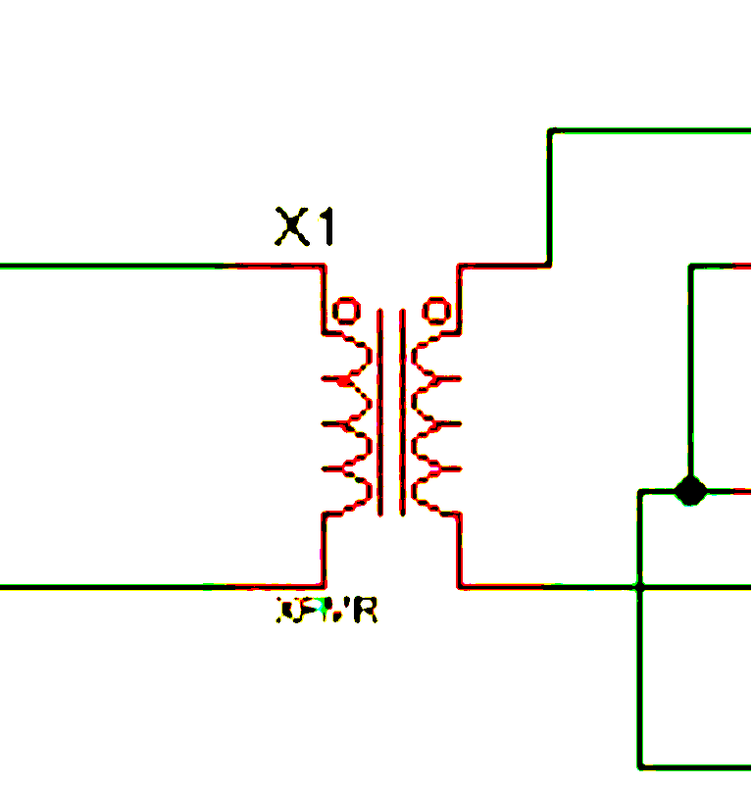
The transformer
The transformer is used to step down the voltage from 220 Vrms to 12 Vrms so the ratio of the number of the primary coil’s turn to that of the secondary is 220/12 which is about 18.33

Slide 4
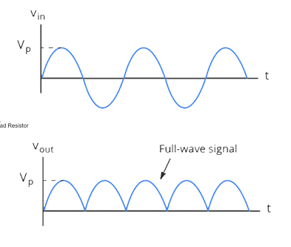
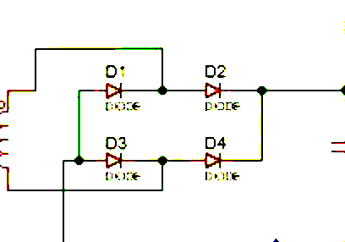
The diode bridge
It uses four diodes to rectify a sine wave as shown :

Slide 5
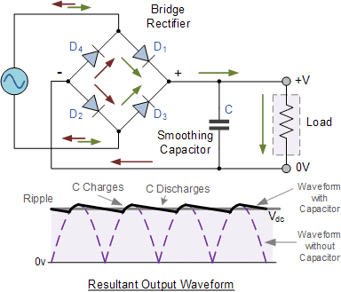
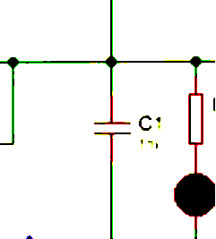
Smoothing capacitor
A filtering capacitor is used to smooth out the pulsating DC output produced by the rectifier,The charging and discharging action creates a relatively constant voltage across the load, significantly reducing the ripple voltage. And since we want a ripple of 0.35V and a current of 40mA so the capacitance can be calculated by the relation C = I /Vripple×f so it would be about 1mF

Slide 6
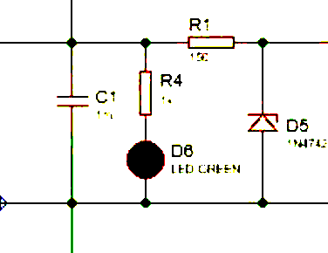
Voltage regulator
A zener diode is used in reverse to maintain a constant 12v across it’s terminals and since we had a 12√2 V (17) – 2×Vdon which is nearly 15.4 v at the capacitor so the rest of the voltage from kvl is on the resistor and we want a current of 21mA so R =V/I ,R= 3.4/21mA So the series resistance is about 160 ohms

Slide 7
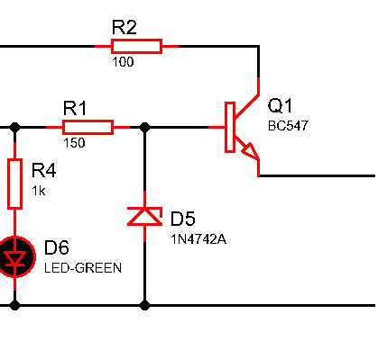
The buffer transistor
Its main purpose is to isolate the two circuits, It acts as a bridge between components with different impedance characteristics. This ensures low output impedance and efficient power transfer.

Slide 8
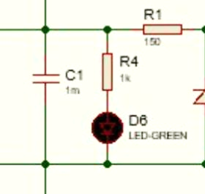
Power on indicator
It’s a basic LED to let us know that the power supply is on , it’s connected parallel to the capacitor to have a 15.4v and the voltage across the LED is about 2.2 so to maintain a 13mA current we need a 1k ohm resistor.

Slide 9
Thanks for your time!!

